Slide 1
Machine Learning Prediction of Taiwan Corporate Credit Risk Index

Slide 2
Introduction
Data
Machine Learning Prediction of Taiwan Corporate Credit Risk Index
Notes:
I will walk you through mainly 3 parts covering motivation, methodology, and expected results.

Slide 3
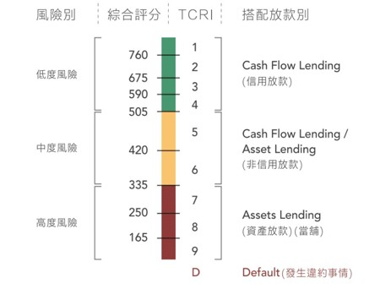
Introduction
Taiwan Corporate Credit Risk Index
Machine Learning Prediction of Taiwan Corporate Credit Risk Index

Slide 4
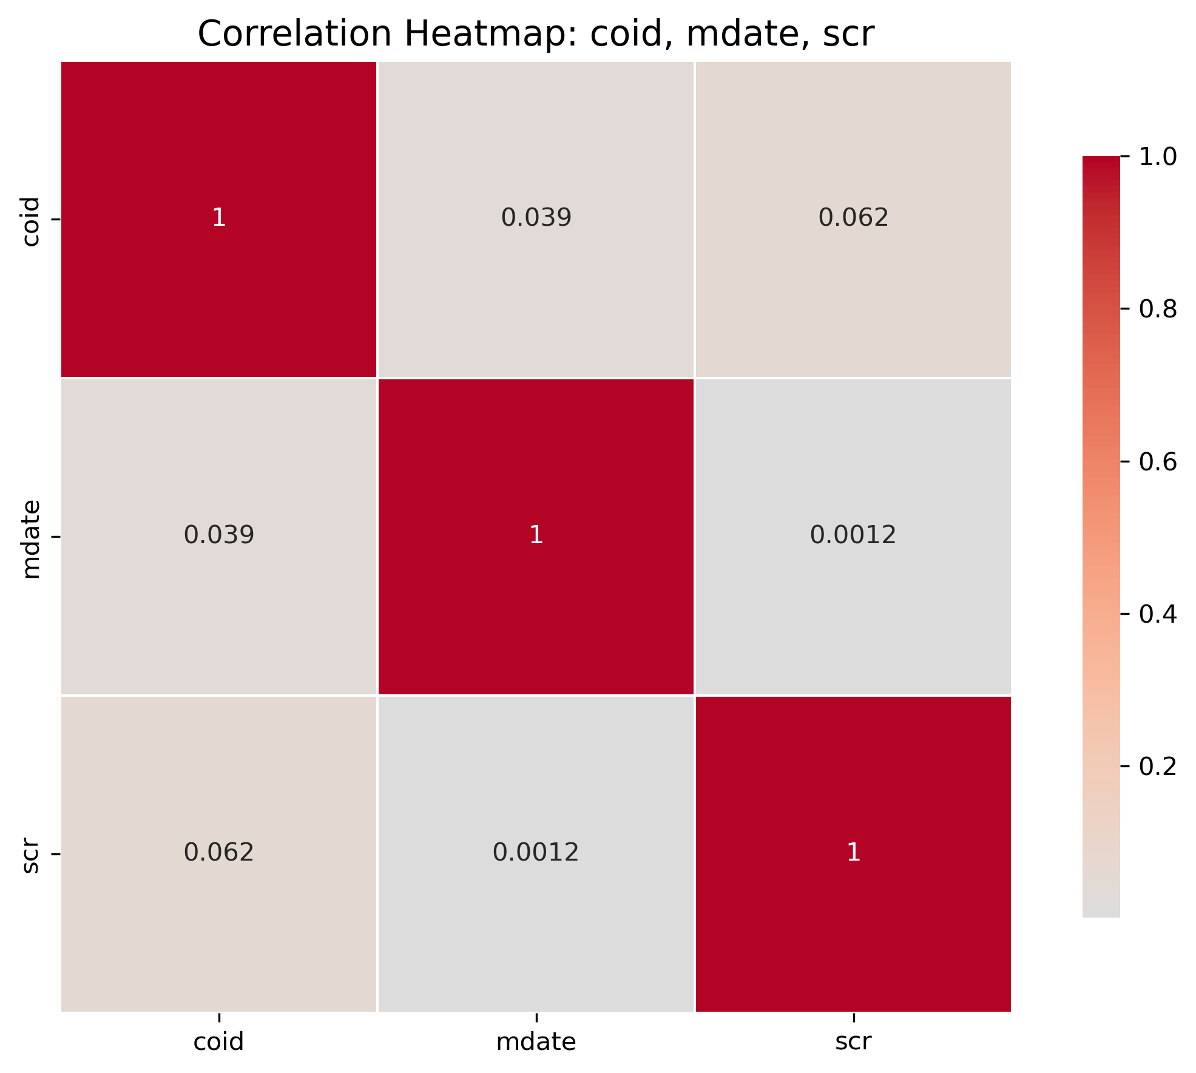
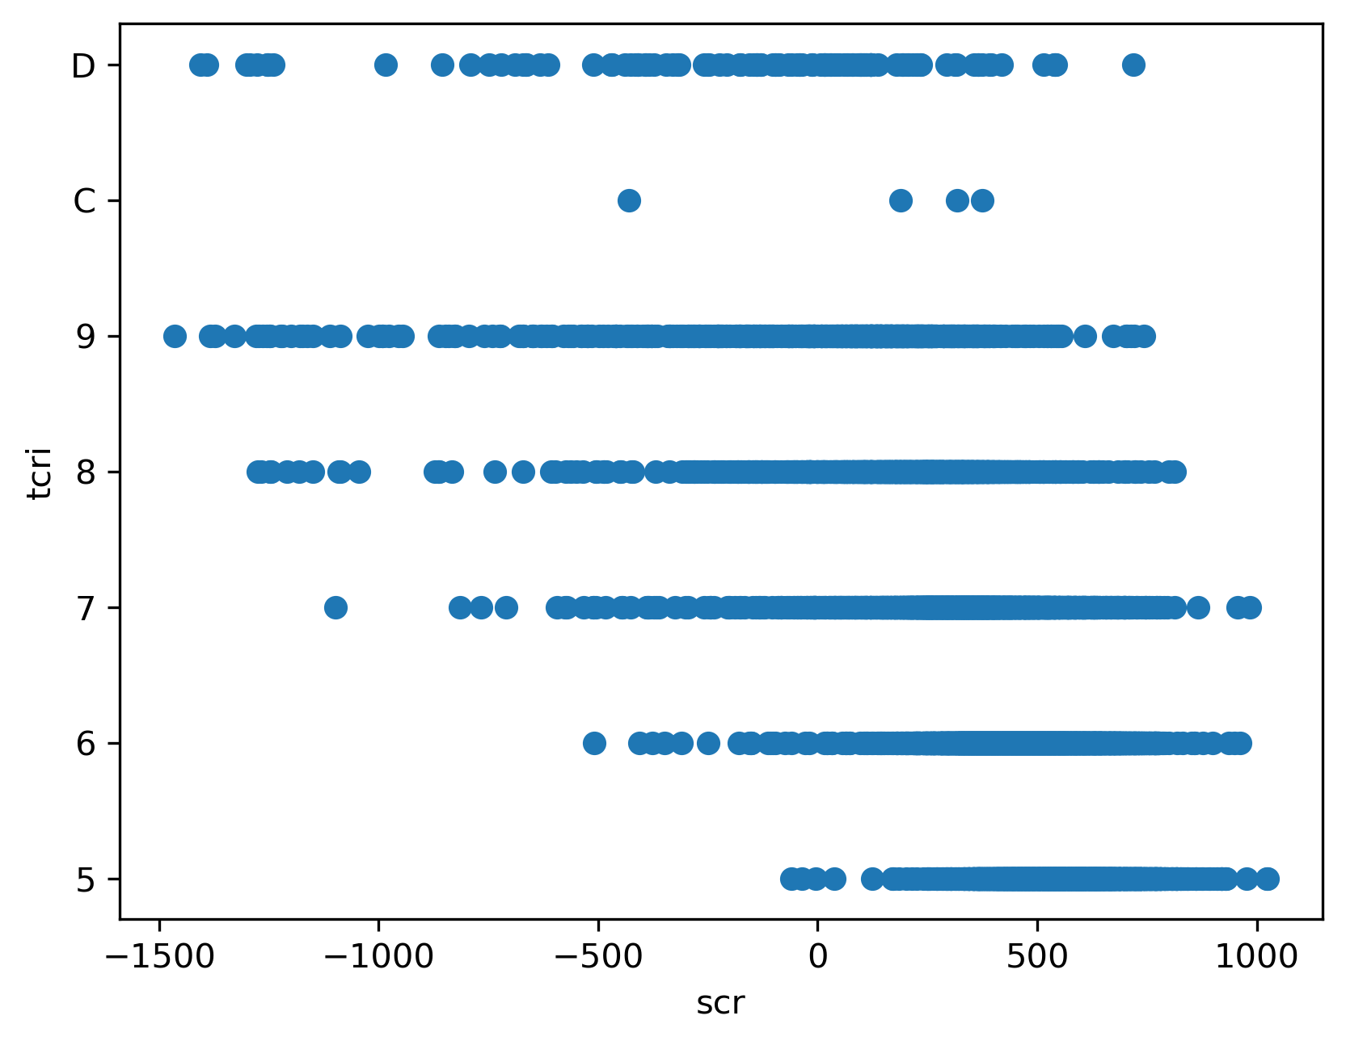
Data
Exploratory Data Analysis (EDA)
Machine Learning Prediction of Taiwan Corporate Credit Risk Index

Slide 5
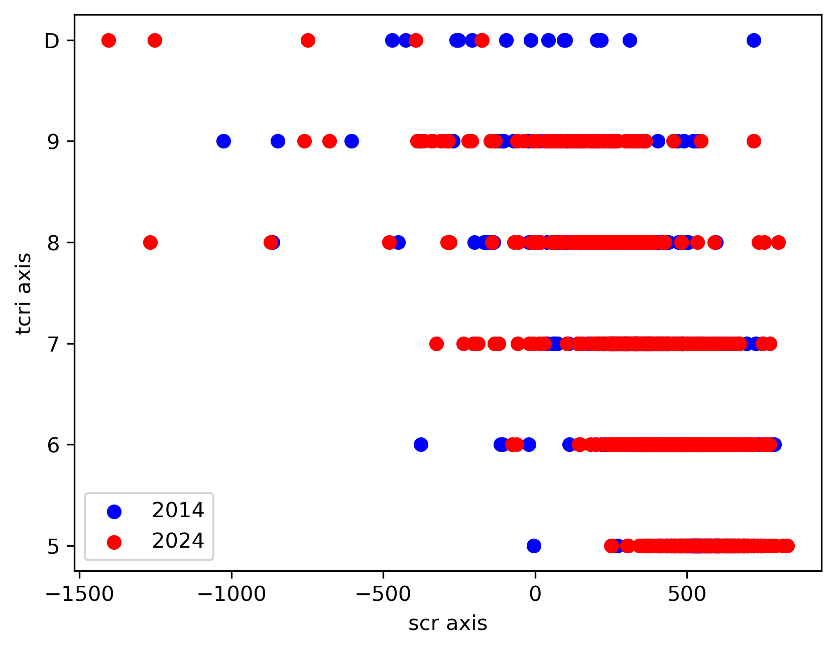
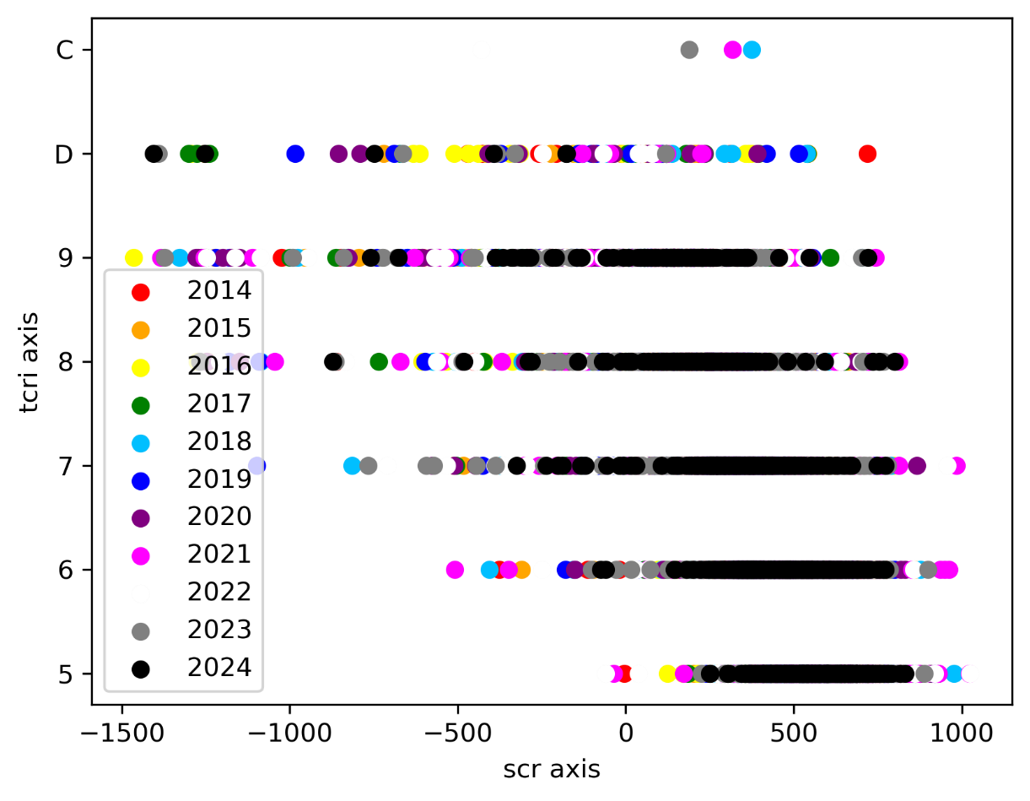
Data
Exploratory Data Analysis (EDA)
Machine Learning Prediction of Taiwan Corporate Credit Risk Index

